Slide 1
Packet Dissection
Karthick
Penetration Tester
This presentation is my own and is not intented to represent the views of my organisation.

Slide 2

Pcap CTF challenge
Run strings on a pcap, find telnet password - feel comfortable with packet analysis

Slide 3
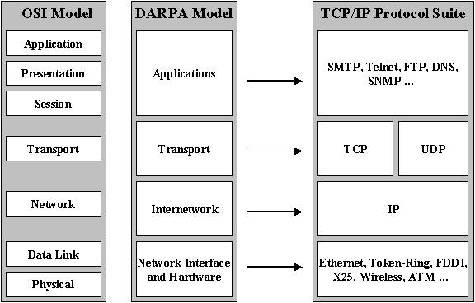
Why PCAPS for analysis/evidence
Disks
End users are now aware of disk encryption
Other evidences (People)
Veracity is hard
Network evidences
Logs
Not every activity can be logged
Netflow
Good for statistical analysis
Pcap
Disk space, processor and memory utilization
Malwares are clever in hiding from system, but not network.
(exemptions: stuxnet)

Slide 4
Information from packets
Control information
Who, Where, When, how
User data
What
This challenge will not focus on the protocol.
tshark 1.12.4 - 1514 protocols

Slide 5
"HALB Corporation is a Fortune 500 company who has 12 office locations across the globe. Especially 5 offices in Australia. They celebrated their new year by gifting every employee a sponge monkey doll. Most of the employees kept the doll in their cubical.
A Intel was received to the company's investigations team stating that one of the monkey doll is an IoT device that is capable of intruding the network and steal information. An incident responder started his hunt for this device by capturing traffic at the Egress router. He was able to identify some strange traffic and confirm the presence of the device within the network. He immediately called in for help from other incident responders for further analysis"
The HALB corp management team is after the following details
1. collect basic Information on this IoT device (Trivial)
2. Retrieve the “complete” information sent from this IoT device.(Challenging)
3. Find the IoT device location to which branch office.(Tough)
“Automation is Key”

Slide 6
Scapy cheat sheet
http://packetlife.net/media/library/36/scapy.pdf
http://www.secdev.org/projects/scapy/doc/usage.html#interactive-tutorial
Can i solve the challenge with tshark or Bro ? - Yes
Can i solve the challenge with only wireshark ? - Not sure if it’s possible (good luck)

Slide 7
Hints:
Question 1: Statistics
Question 2: Math or Patterns https://www.sans.org/reading-room/whitepapers/detection/base64-pwned-33759
Question 3: Hex
Code skeleton ?
Solution:
Will go through the pdf.

Slide 8
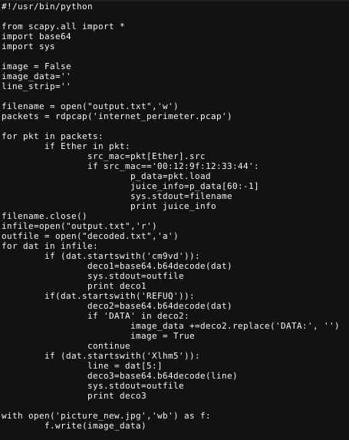
Decoding:

Slide 9
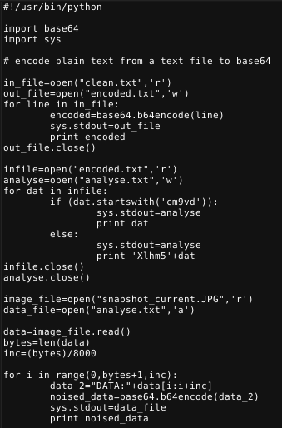
Encoding:

Slide 10
How do we Acquire ?
Switches - Port mirroring
Destination port speed is a consideration
Network Taps
Installation downtimes
Wireless
consideration due to RF medium

Slide 11
Some Considerations
NAT
Information stitching might be needed
Encryption
Makes it impossible to inspect
Tunnels and VPN
Need to identify the tunnels first
Sensor placement is important
How about VPN-to-somewhere else ?

Slide 12
Some Considerations
Other Network components ( Riverbed steelhead,F5……)
Know if they alter traffic for speed considerations
Cloud
Uncharted territory
BYOD
You might end up collecting personal traffic
Data , voice, security cams, video, storage ? ? ?

Slide 13

Where should i place my capture sensors ?
In a network portion that covers your intellectual property
Common packet capture tool - vendor statement

Slide 14

Blue Team

Slide 15

Red Team
“Theatricality and deception are powerful agents”
Provide them false C2 domains - Cobalt Strike
Even name your fake payloads “WCryVer8” (Deadly move)
These efforts are to buy you more time, and keeping your blue team away from you for a while

Slide 16

Stay in touch
Twitter: @_jquest__

